Slide 1
Mutual Inductance, Dot Convention, Differential Equations, and S Domain Model
Linear Circuit Analysis II
EECE 202 – Spring 2025

Slide 2
Announcement
PD2 (Technical Report) due Thursday Week 12
Recap
Resonance
Series RLC circuit
Parallel RLC circuit
New Material
Mutual inductance and its equations in time and s domain
Transformers
Dot conventions

Slide 3
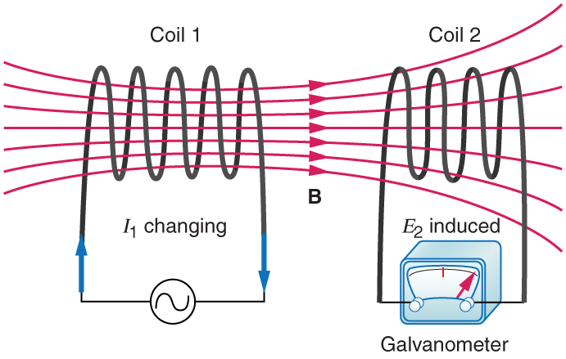
Mutual inductance

Slide 4
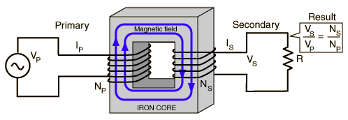
Transformers
https://www.youtube.com/watch?v=d7InRZokfzY&t=11s

Slide 5
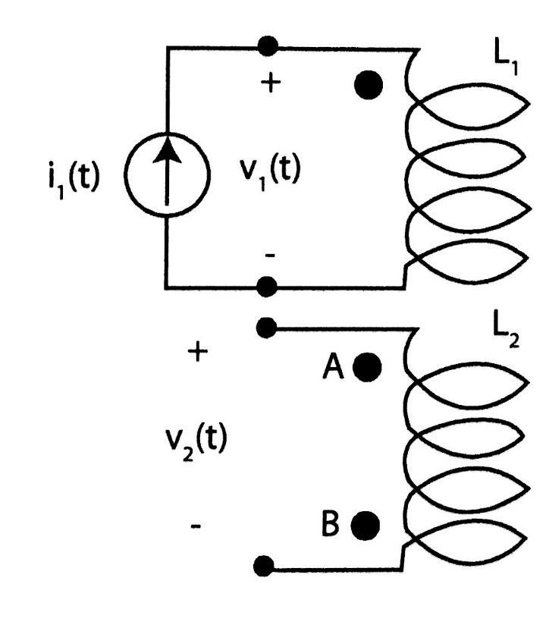
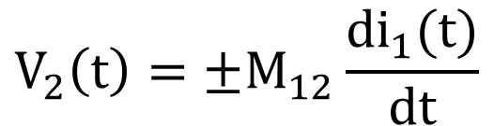
Mutual inductance
$$V_{2}\left(t\right)=±M_{12}\frac{di_{1}(t)}{dt}$$
L - is the coil inductance
M - is the mutual inductance

Slide 6
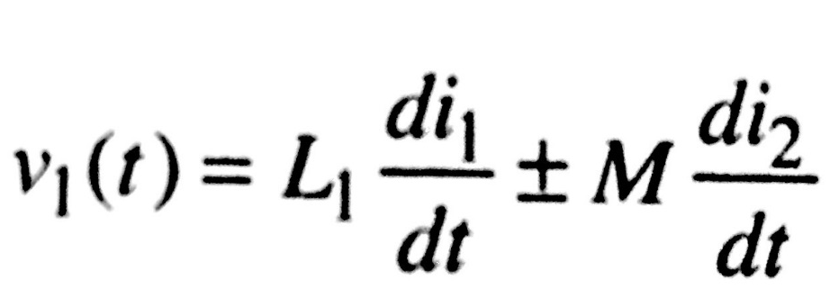
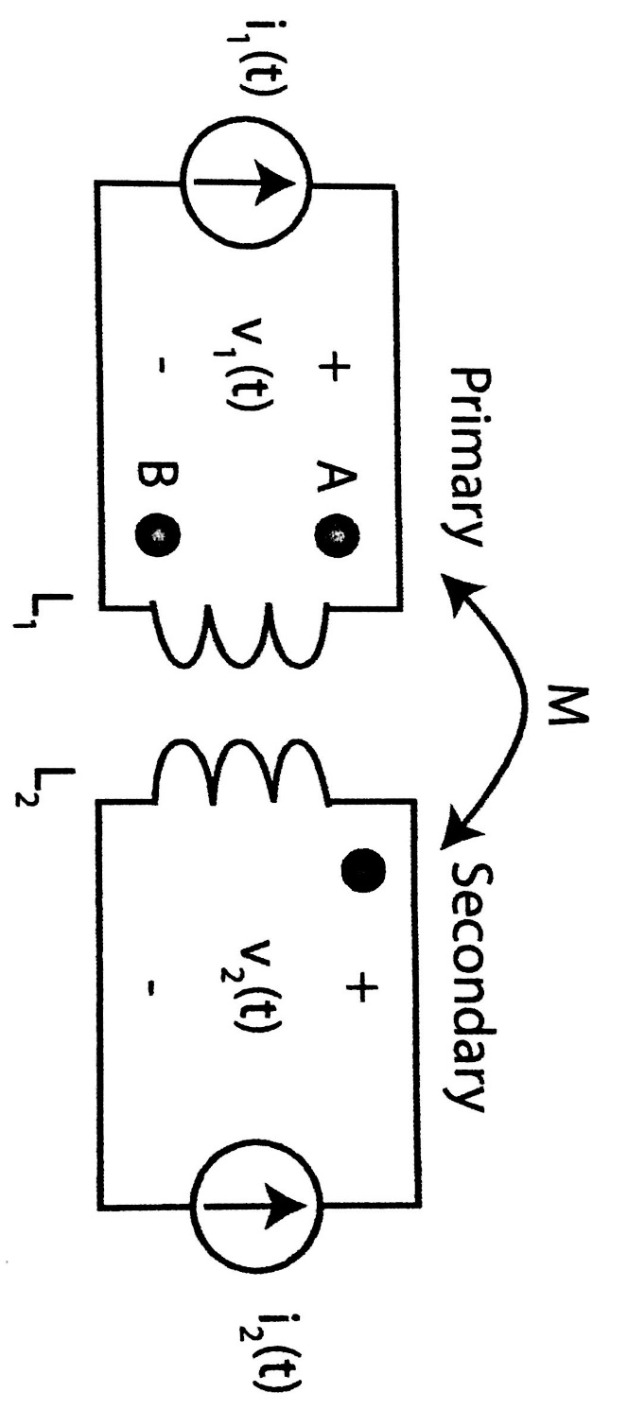

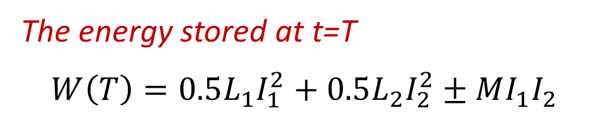
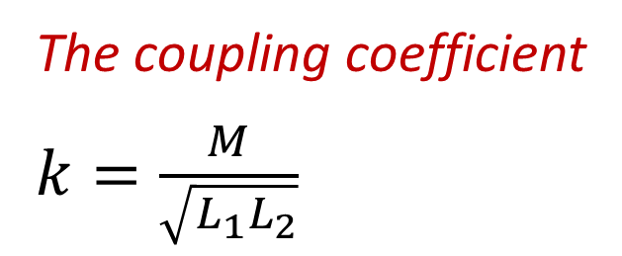
Mutual inductance equations in the time domain
The coupling coefficient
$k=\frac{M}{\sqrt{L_{1}L_{2}}}$
The energy stored at t=T
$$W\left(T\right)=0.5L_{1}I_{1}^{2}+0.5L_{2}I_{2}^{2}±MI_{1}I_{2}$$

Slide 7
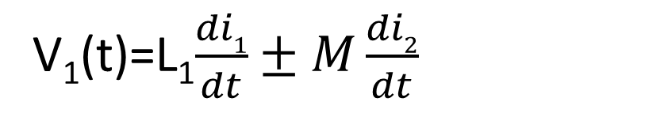
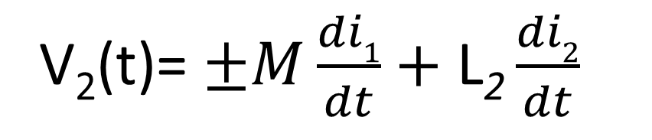
Mutual inductance equations in the time domain
salman
V₁(t)=L₁$\frac{di1}{dt}±M\frac{di2}{dt}$
V₂(t)= $±M\frac{di1}{dt}+\text{L}\text{2}\frac{di2}{dt}$
The coupling coefficient
$k=\frac{M}{\sqrt{L_{1}L_{2}}}$
The energy stored at t=T
$$W\left(T\right)=0.5L_{1}I_{1}^{2}+0.5L_{2}I_{2}^{2}±MI_{1}I_{2}$$

Slide 8
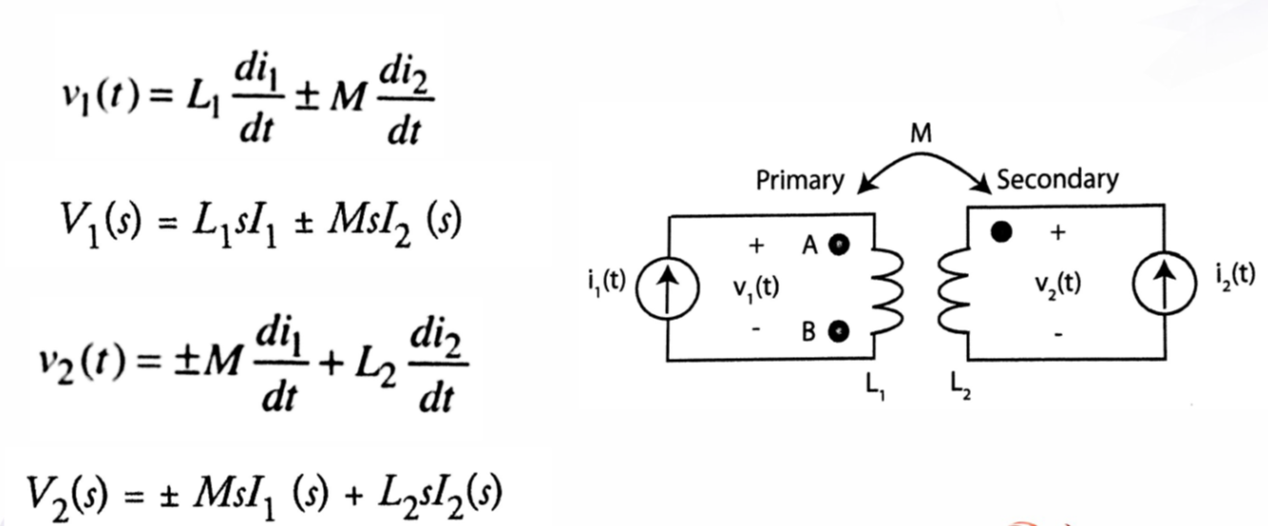
Mutual inductance equations in the Laplace domain

Slide 9
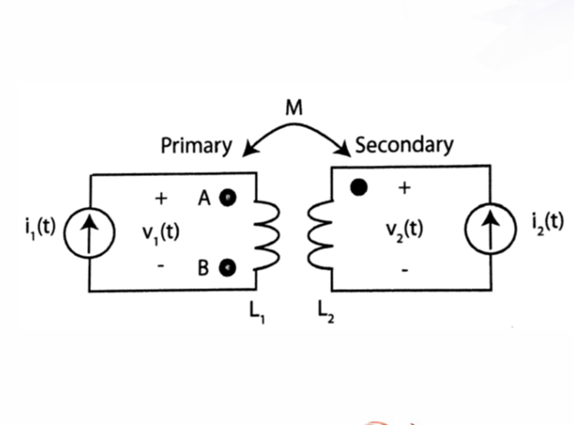
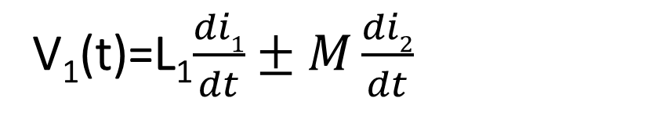
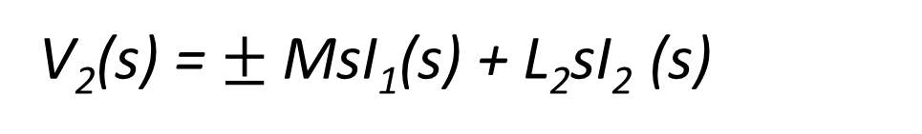
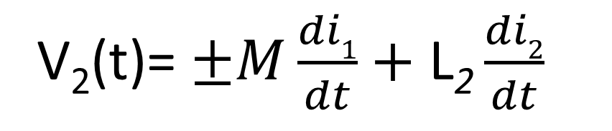
Mutual inductance equations in the Laplace domain
salman
V₁(t)=L₁$\frac{di1}{dt}±M\frac{di2}{dt}$
V₁(s) = L₁sI₁ + MsI₂(s)
V₂(t)= $±M\frac{di1}{dt}+\text{L}\text{2}\frac{di2}{dt}$
V₂(s) = $±$MsI₁(s) + L₂sI₂ (s)

Slide 10
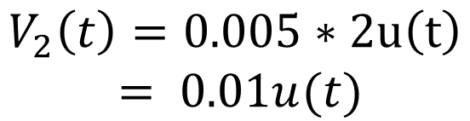
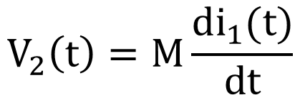
Example
In the shown figure, if i1(t)=2tu(t) A and M=0.005H. Determine the value of V2(t).
(The dot is at position A)
$$V_{2}\left(t\right)=M\frac{di_{1}(t)}{dt}$$
I2(t)
$$V_{2}\left(t\right)=0.005∗2u\left(t\right)$$
$$= 0.01u(t)$$

Slide 11
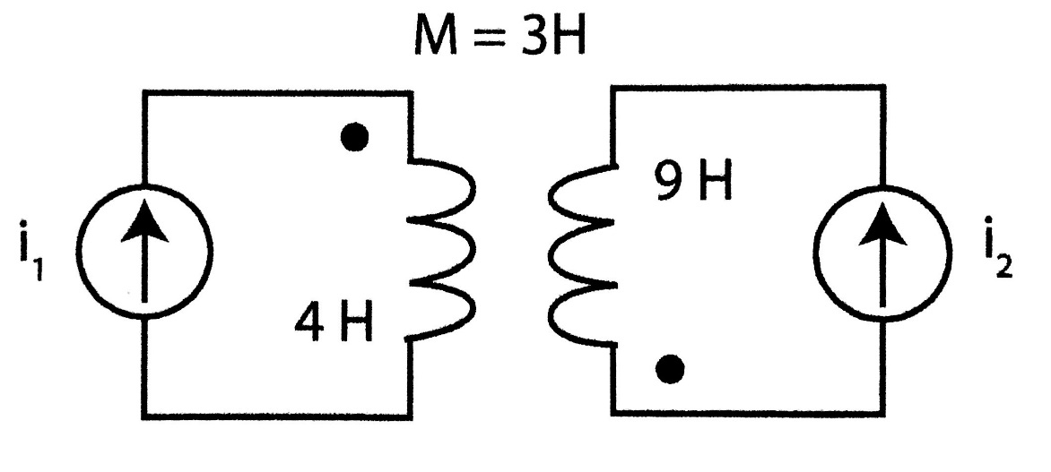
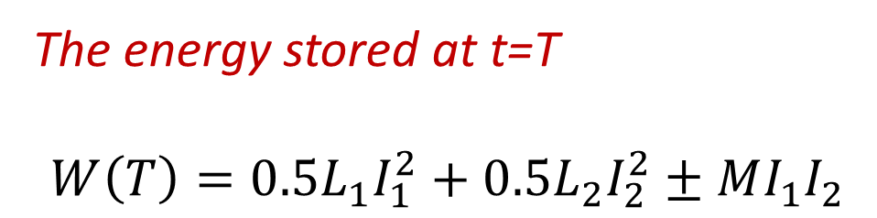
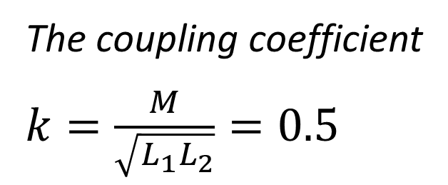
Example
For the shown figure, i1(T)=6A and i2(T)=2A . Find the coupling coefficient (k) and the energy stored by the inductors at t=T.
The coupling coefficient
$k=\frac{M}{\sqrt{L_{1}L_{2}}}=0.5$
The energy stored at t=T
$$W\left(T\right)=0.5L_{1}I_{1}^{2}+0.5L_{2}I_{2}^{2}±MI_{1}I_{2}$$

Slide 12
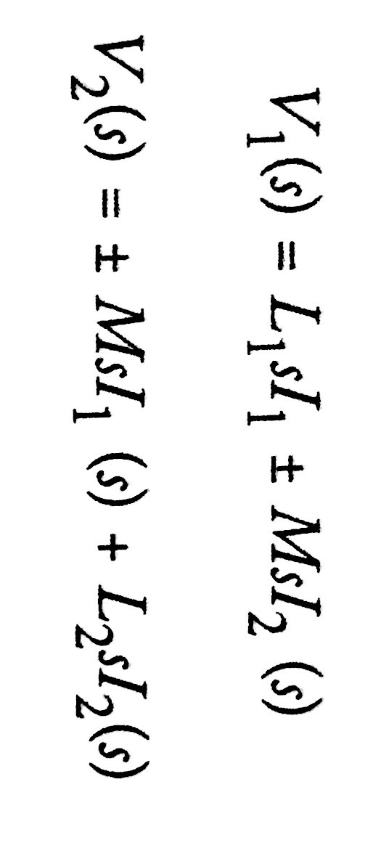
Mutual inductance equations in S-domain

Slide 13
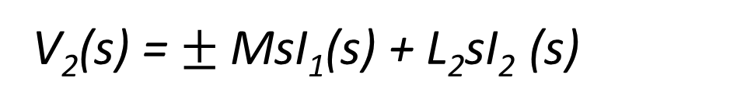
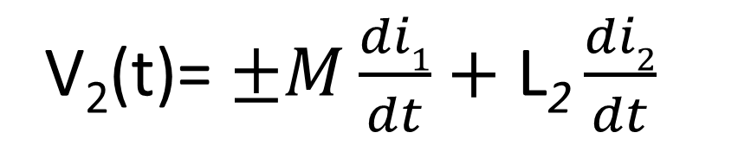
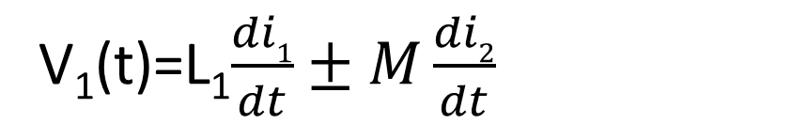
Mutual inductance equations in S-domain
salman
V₁(t)=L₁$\frac{di1}{dt}±M\frac{di2}{dt}$
V₁(s) = L₁sI₁ + MsI₂(s)
V₂(t)= $±M\frac{di1}{dt}+\text{L}\text{2}\frac{di2}{dt}$
V₂(s) = $±$MsI₁(s) + L₂sI₂ (s)

Slide 14
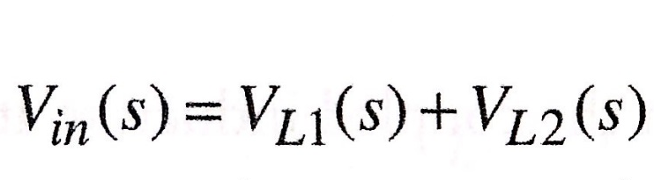

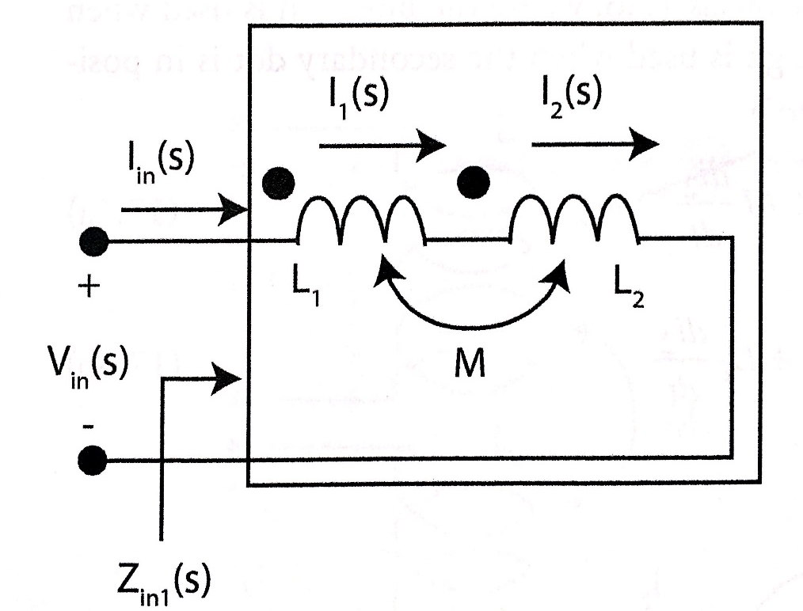

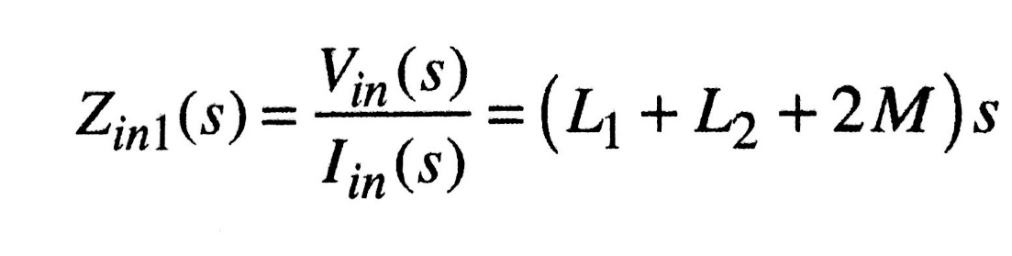
Example
For the circuit shown, Find the input impedance Zin.

Slide 15
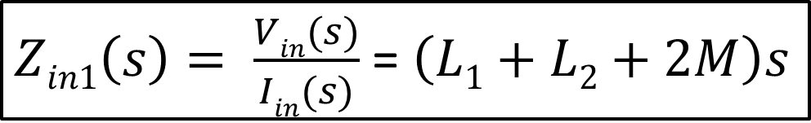
Example
salman
For the circuit shown, Find the input impedance Zin.
V_{in}(s)= V_{L1} (s) + V_{L2} (s)
= (L₁s +Ms)I_{in} (s) + (Ms + L₂s)I_{in} (s)
=(L₁ + L₂ + 2M)sI_{in}(s)
$Zin1\left(s\right)= \frac{Vin(s)}{Iin(s)}$ = $\left(L1+L2+2M\right)s$

Slide 16
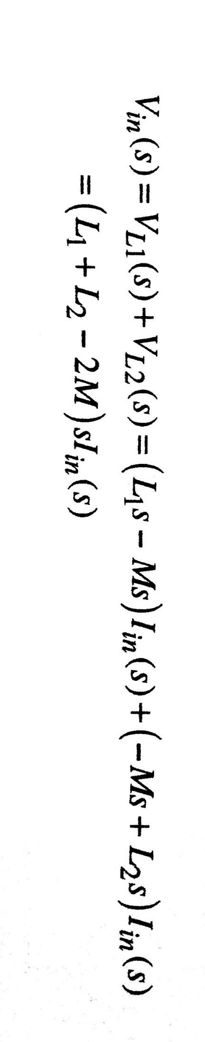
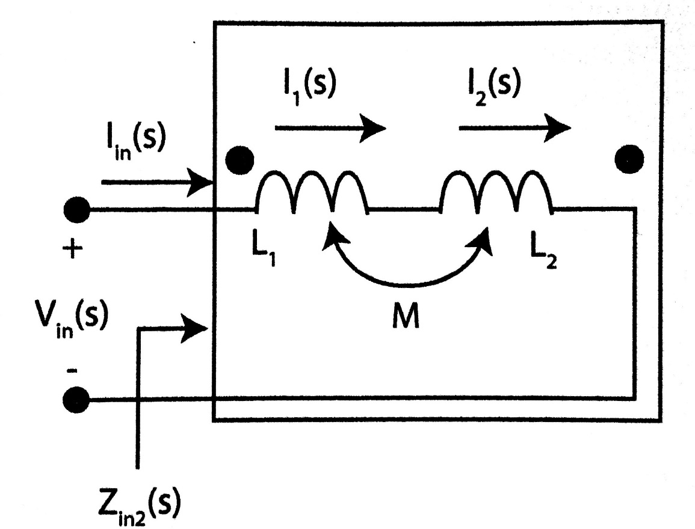
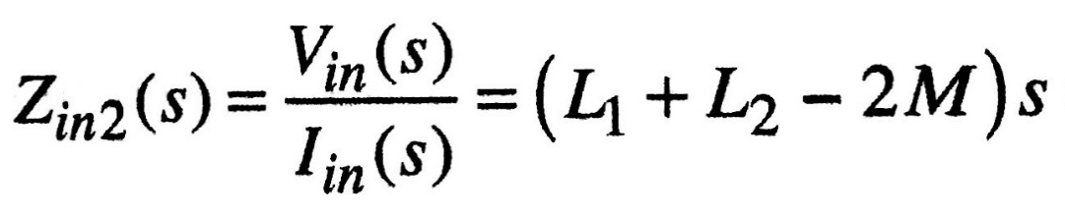
Example
For the circuit shown, Find the input impedance Zin.

Slide 17
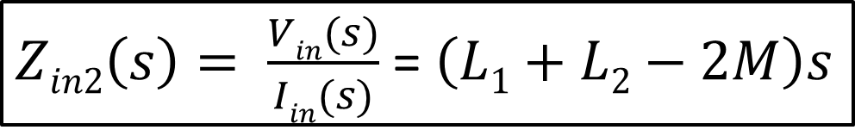
Example
salman
For the circuit shown, Find the input impedance Zin.
V_{in}(s)= V_{L1} (s) + V_{L2} (s)
= (L₁s - Ms)I_{in} (s) + (-Ms + L₂s)I_{in} (s)
=(L₁ + L₂ - 2M)sI_{in}(s)
$Zin2\left(s\right)= \frac{Vin(s)}{Iin(s)}$ = $\left(L1+L2−2M\right)s$

Slide 18
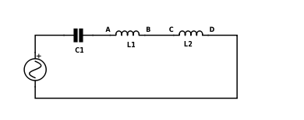
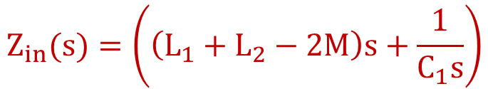
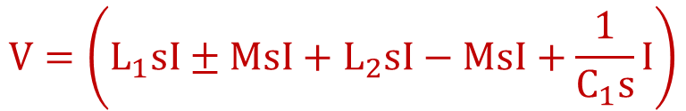
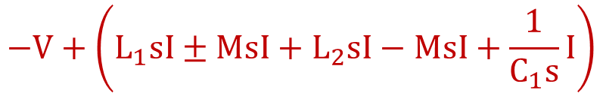
Example
For the circuit shown, Find the input impedance Zin(s). Consider the mutual inductance effect between L1 and L2 where the dots are at B and C.
$$−V+\left(L_{1}sI±MsI+L_{2}sI−MsI+\frac{1}{C_{1}s}I\right)$$
$$V=\left(L_{1}sI±MsI+L_{2}sI−MsI+\frac{1}{C_{1}s}I\right)$$
$$Z_{in}(s)=\left(\left(L_{1}+L_{2}−2M\right)s+\frac{1}{C_{1}s}\right)$$

Slide 19
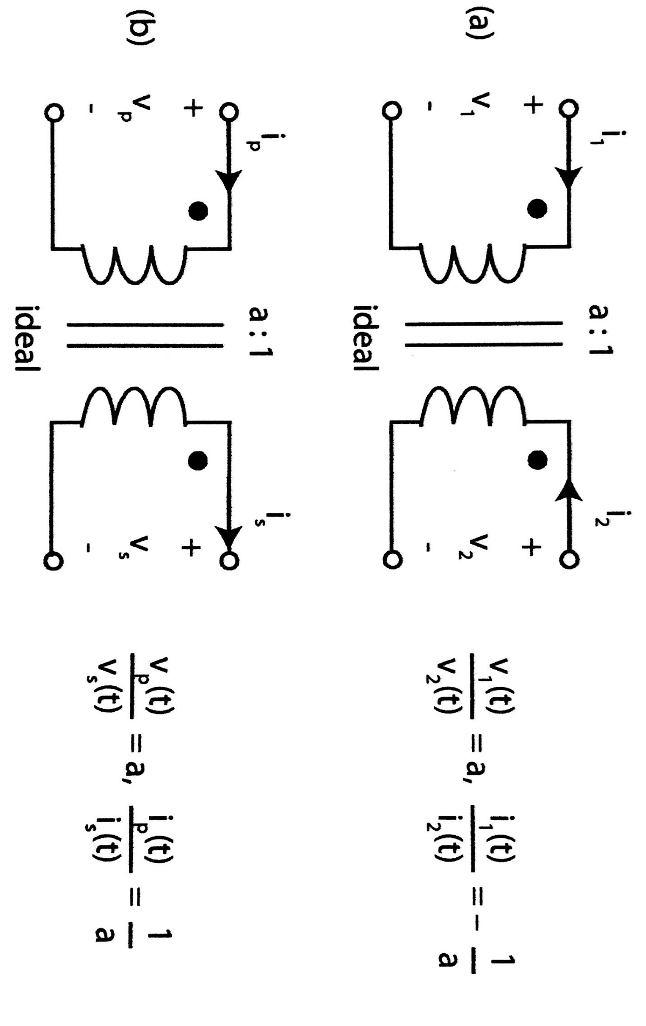
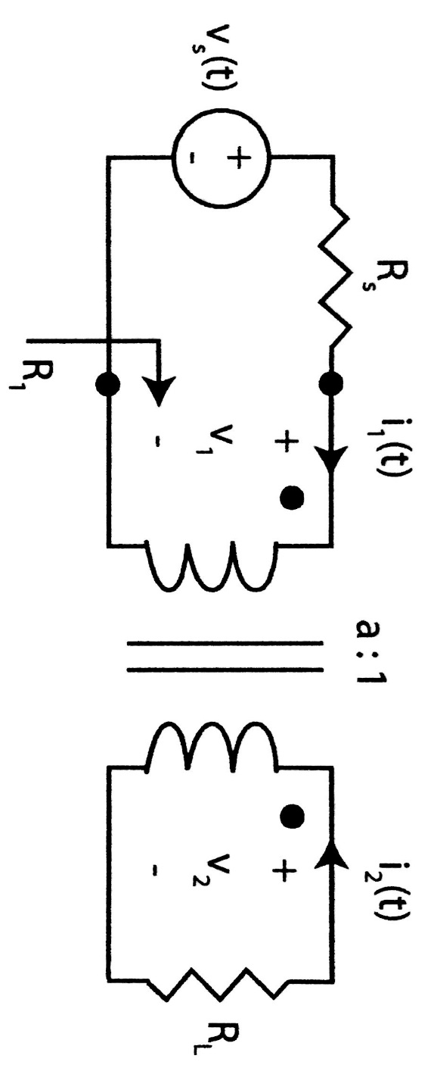
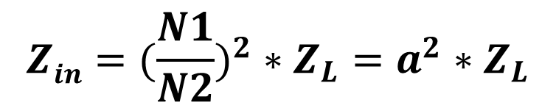


Ideal Transformers
$$a=\frac{N1}{N2}$$
$$Z_{in}$$
$$Zin=(\frac{N1}{N2})^{2}∗Z_{L}=a^{2}∗Z_{L}$$

Slide 20
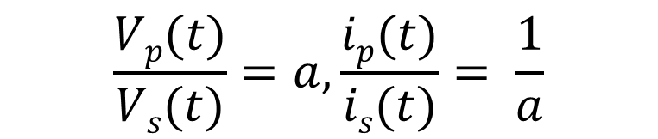
Ideal Transformers
salman
$$\frac{Vp(t)}{Vs(t)}=a, \frac{ip(t)}{is(t)}= \frac{1}{a}$$
$$a=\frac{N1}{N2}$$
$$Z_{in}$$
$$Zin=(\frac{N1}{N2})^{2}∗Z_{L}=a^{2}∗Z_{L}$$

Slide 21
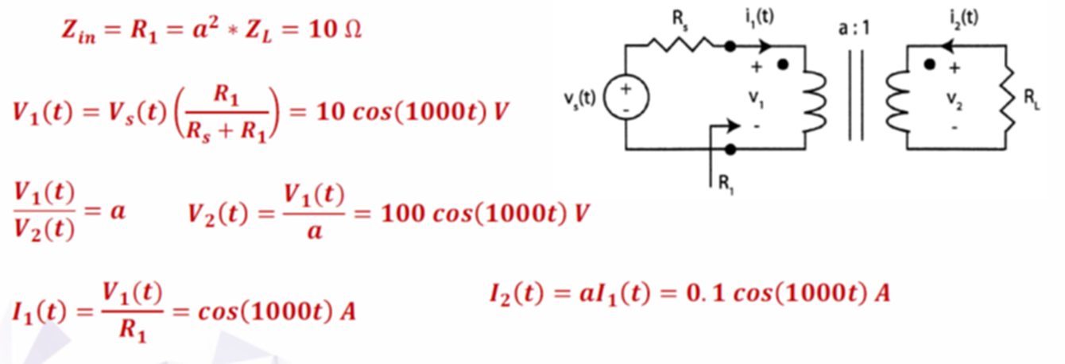
Example
For the circuit shown, Rs=10Ω, a=0.1, RL=1kΩ and Vs=20cos(1000t). Find R₁, V₁, V₂, I₁ and I₂.

Slide 22
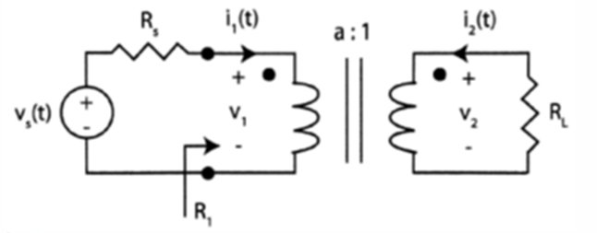
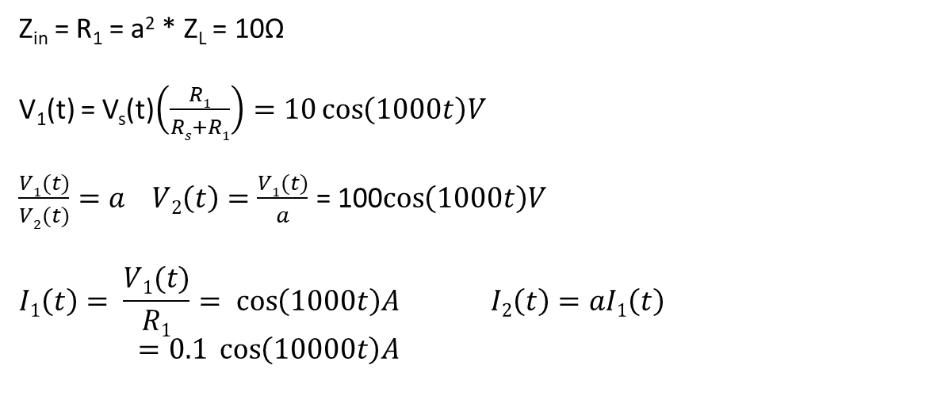
Example
salman
For the circuit shown, Rs=10Ω, a=0.1, RL=1kΩ and Vs=20cos(1000t). Find R₁, V₁, V₂, I₁ and I₂.
Z_{in} = R₁ = a² * Z_{L} = 10$\text{Ω}$
V₁(t) = V_{s}(t)$\left(\frac{R1}{Rs+R1}\right)=10\cos\left(1000t\right)V$
$\frac{V1(t)}{V2(t)}=a V2\left(t\right)=\frac{V1(t)}{a}$ = 100$\cos\left(1000t\right)V$
$$I1\left(t\right)= \frac{V1(t)}{R1}= \cos\left(1000t\right)A I2\left(t\right)=aI1\left(t\right)=0.1 \cos\left(10000t\right)A$$

Slide 23
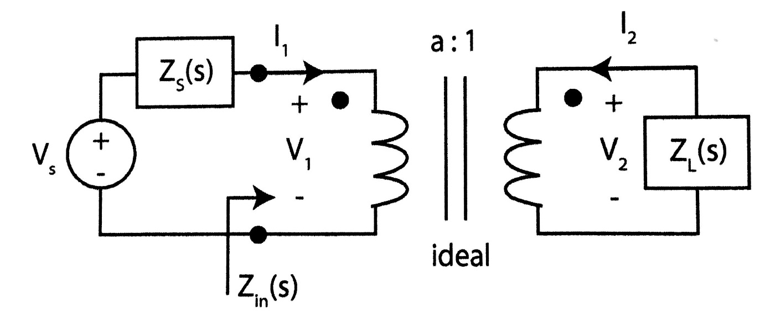
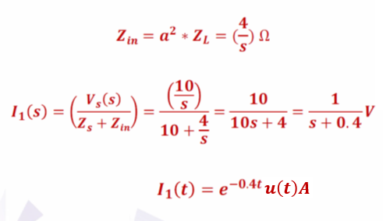
Example
For the circuit shown, if Zs=10Ω, Z_{L}=(1/S), Vs(t)=10u(t) and a=2. find I₁(s) and I₁(t).

Slide 24
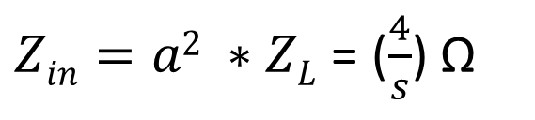

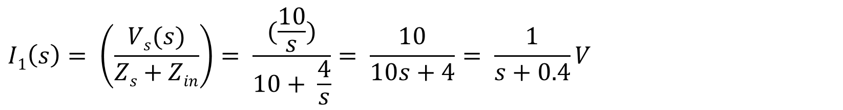
Example
salman
For the circuit shown, if Zs=10Ω, Z_{L}=(1/S), Vs(t)=10u(t) and a=2. find I₁(s) and I₁(t).
$Zin=a2 ∗ZL$ = ($\frac{4}{s}$) Ω
$$I1\left(s\right)= \left(\frac{Vs(s)}{Zs+Zin}\right)= \frac{(\frac{10}{s})}{10+ \frac{4}{s}}= \frac{10}{10s+4}= \frac{1}{s+0.4}V$$
$$I1\left(t\right)= e^{−0.4t} u\left(t\right)A$$

Slide 25
Answer the following questions using ChatGPT
What is mutual inductance, and how does it relate to the inductance of individual coils?
Explain the significance of the dot convention in mutual inductance.
How does the position of dots affect the induced voltage polarity?
Describe the conditions under which mutual inductance can occur between two coils.
What happens to mutual inductance if the coils are moved farther apart?
How does the mutual inductance term affect the input impedance in the S-domain for a circuit?
Explain how the turns ratio a in a transformer affects the primary and secondary voltages and currents.

Slide 26
Answer the following questions using ChatGPT
Mutual Inductance is the phenomenon where a changing current in one coil induces a voltage in a nearby coil
This depends on the geometry, distance, and magnetic coupling of the coils.
The dot convention indicates the polarity of induced voltages in mutually coupled coils and determines
The coupling coefficient k, ranging from 0 to 1, represents the efficiency of magnetic coupling between two inductors
Coupled inductors store energy in their magnetic fields, and mutual inductance facilitates energy transfer between the coils
Transformers use mutual inductance to transfer power between circuits, with ideal transformers simplifying analysis through turns ratio �a and input-output impedance relationships.

